Slide 1

Enhanced Identity-Based Delegated Data Integrity Auditing for Secure Cloud Storage Using Digital Signatures and SIEM
PROJECT TITLE
Syrian Private University · Faculty of Artificial Intelligence Engineering
Prepared by
Supervised by
Ruba Tadmory & Nawar Alani
Wassim Aljuneidi

Slide 2
Introduction, Problem and Objective
Cloud storage lets owners outsource their data but removes their direct control. Owners often need another user to upload files on their behalf.
Background
Uncontrolled delegation exposes the cloud to impersonation, privilege abuse, and replayed requests. Existing work covers delegation, evidence, or monitoring separately, not together.
Problem
Build a framework that combines identity-based controlled delegation, data integrity auditing, digital signatures, and SIEM monitoring.
Objective

Slide 3
Previously Completed Phases
Applications Project: MPNR framework based on Feng & Chen (2013)
Storage
Signatures
Nextcloud on Ubuntu Server
RSA with SHA-256 hashing for authenticity and integrity
Evidence
Monitoring
Broadcast Session, non-repudiation receipt (NRR), and Trusted Third Party (TTP)
Wazuh custom rules for signature failures and rollback attacks

Slide 4
Literature Review
Paper
Authors, publisher, year
What we gained
Investigation on Storage-Level Data Integrity Strategies in Cloud Computing: Classification, Security Obstructions, Challenges and Vulnerability
P. Goswami et al., Journal of Cloud Computing, 2024
Background on integrity threats and verification methods
Identity-Based Controlled Delegated Outsourcing Data Integrity Auditing Scheme
J. Du et al., Scientific Reports, 2024
Main basis of our work: the controlled delegation idea behind CDAP
Sec-Auditor: A Blockchain-Based Data Auditing Solution for Ensuring Integrity and Semantic Correctness
G. Han and H. Li, Computers, Materials & Continua, 2024
Tamper-resistant audit records, kept as a future extension
An Improved Blockchain-Based Cloud Auditing Scheme Using Dynamic Aggregate Signatures
H. Lei et al., Computers, Materials & Continua, 2026
Combining hashes and signatures, kept as a future extension
Integrated Protocol for Verifiable Confidential Cloud Computing and Data Integrity Auditing
R. Li et al., Journal of King Saud University Computer and Information Sciences, 2025
A direction for adding confidentiality and privacy later

Slide 5
Implementation Stages and Tools
1. Environment
2. Core framework
3. Authentication
Virtual lab, server, and Wazuh installation
Hash, sign, secure upload, evidence, verification
User login and account management
4. CDAP protocol
5. SIEM integration
6. Evaluation
Create delegation, delegated upload, revocation
Delegation events sent to Wazuh with alerts
Attack tests and comparison with traditional storage
Tools
VMware Workstation
Ubuntu Server
Nextcloud
OpenSSL
Wazuh SIEM
Virtual lab
Server OS
Cloud storage
RSA, SHA-256
Monitoring

Slide 6
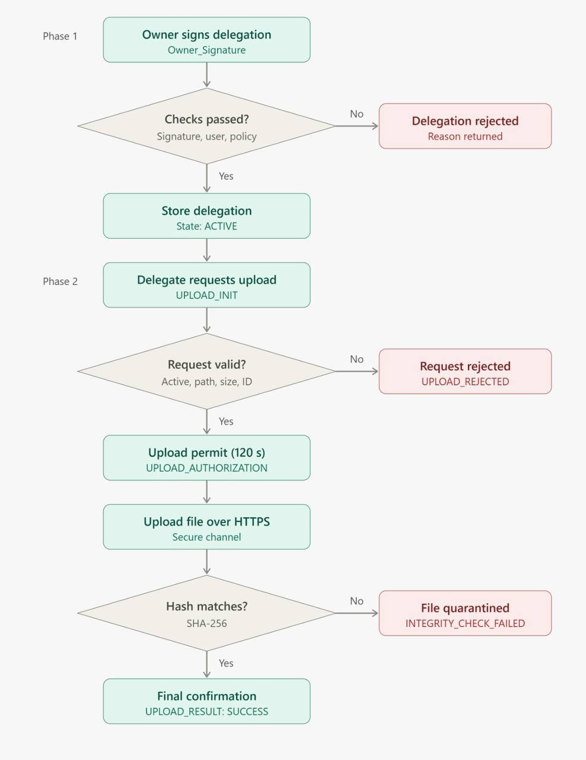
Controlled Delegation Protocol (CDAP)
Phase 1
The owner signs and registers a limited delegation
Phase 2
The delegate uploads using a short-lived permit, then SHA-256 verifies the file
Every rejection and integrity failure is logged to Wazuh.

Slide 7
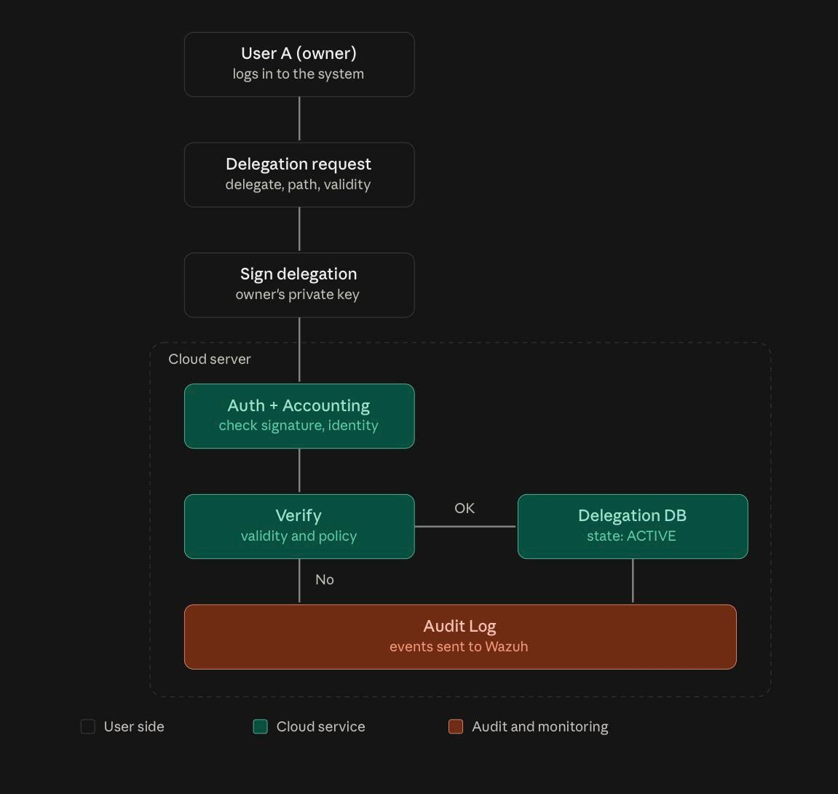
CDAP Phase One: Creating a Delegation
1. Request
Owner defines delegate, path, and validity, then signs with a private key
2. Verification
Cloud checks signature, identity, validity, and policy
3. Registration
Delegation is stored as ACTIVE and events go to Wazuh

Slide 8
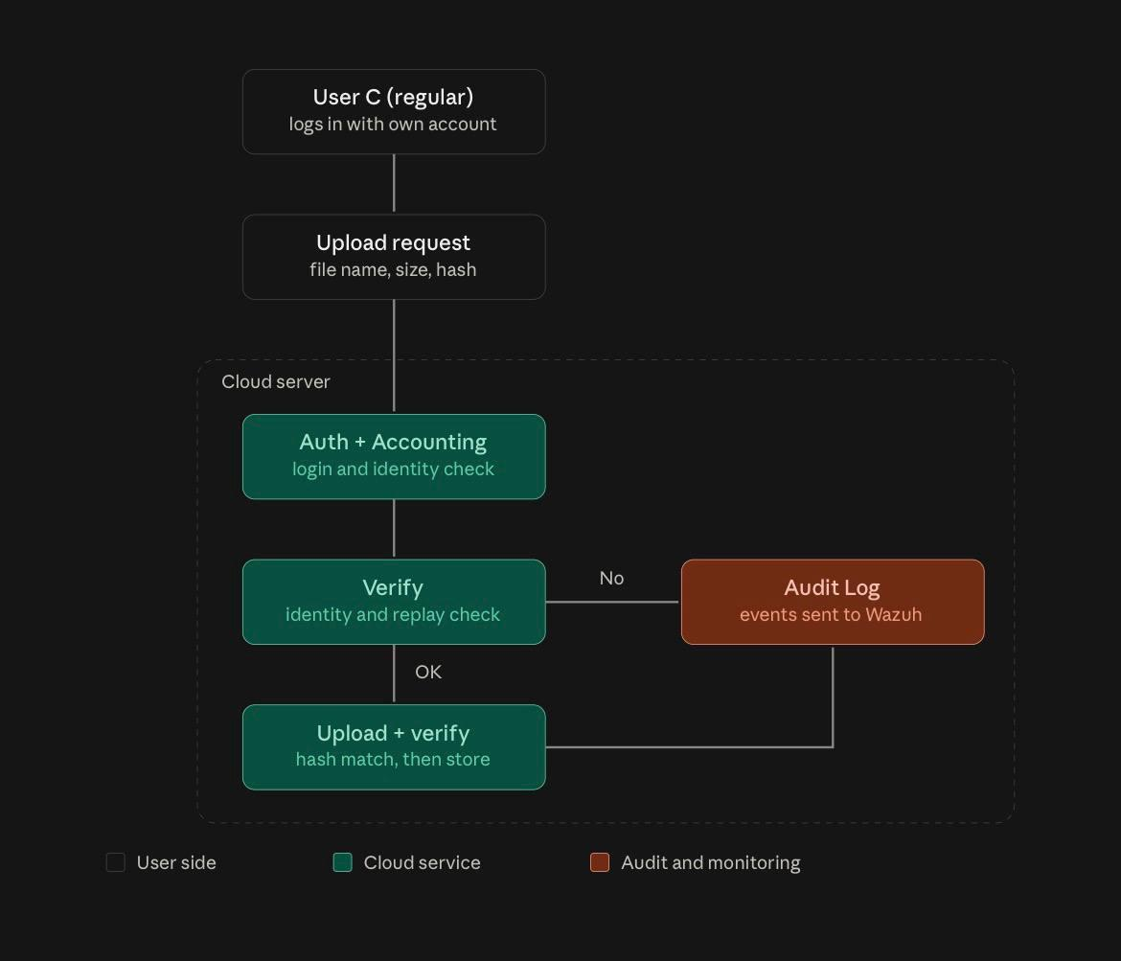
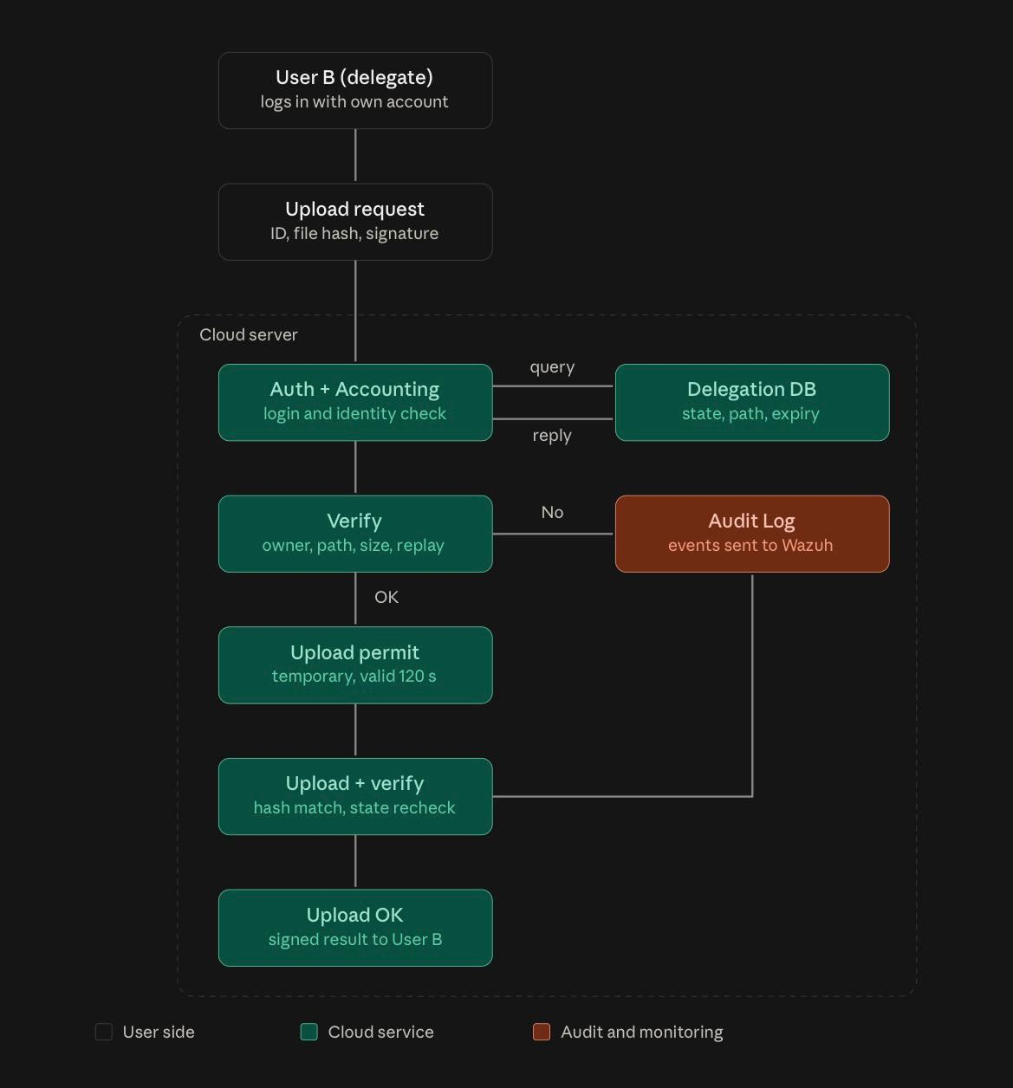
Standard Upload vs. Delegated Upload (Phase Two)

Slide 9
Project Plan: Done and Remaining
Done
Remaining
Verified the first project's work
Write the delegation revocation code
Designed the protocol, its messaging, and the delegation mechanism
Nextcloud Integration: Connect the file upload service to Nextcloud
Designed the block diagrams and the flowchart
Test replayed, expired, and tampered requests, then evaluate
Set up the delegation and digital signature mechanism
Built a script to verify delegations
Complete the real alerts in Wazuh
Built a file upload service with Python and Flask
Run the final evaluation tests and document the results
Added file integrity checks with SHA-256
Complete the integration and the final security controls
Prepared log collection and alert rules in Wazuh
Finalize the report
Working components with successful tests so far

Slide 10
References
[1] J. Feng and Y. Chen, “A fair non-repudiation framework for data integrity in cloud storage services,” International Journal of Cloud Computing, vol. 2, no. 1, pp. 20–47, 2013.
[2] P. Goswami et al., “Investigation on storage level data integrity strategies in cloud computing: Classification, security obstructions, challenges and vulnerability,” Journal of Cloud Computing, vol. 13, art. 45, 2024.
[3] J. Du et al., “Identity-based controlled delegated outsourcing data integrity auditing scheme,” Scientific Reports, vol. 14, art. 7582, 2024.
[4] G. Han and H. Li, “Sec-Auditor: A blockchain-based data auditing solution for ensuring integrity and semantic correctness,” Computers, Materials & Continua, vol. 80, no. 2, pp. 2121–2137, 2024.
[5] H. Lei et al., “An improved blockchain-based cloud auditing scheme using dynamic aggregate signatures,” Computers, Materials & Continua, vol. 86, no. 2, 2026.
[6] R. Li et al., “Integrated protocol for verifiable confidential cloud computing and data integrity auditing,” Journal of King Saud University Computer and Information Sciences, vol. 37, art. 299, 2025.

